Slide 1

Smart Office
Automated smart office

Slide 2

Group Members CSE 324 (B)
Fariha Ahmed Saki
Fariha Hasan
Md Mehedi Hasan

Slide 3
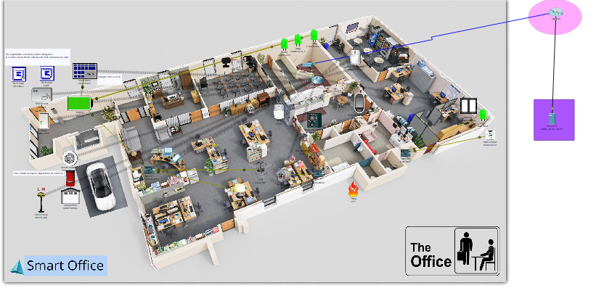
Video slide
Project Features:

Slide 4
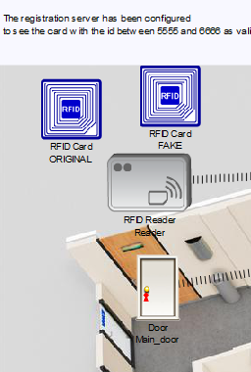
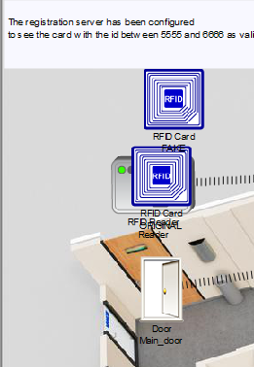
1.RFID based Door Lock

Slide 5
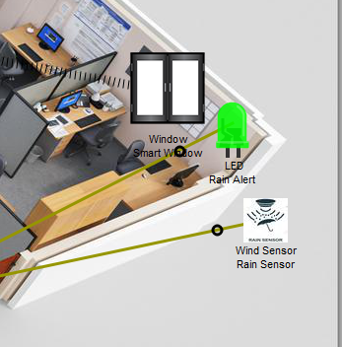
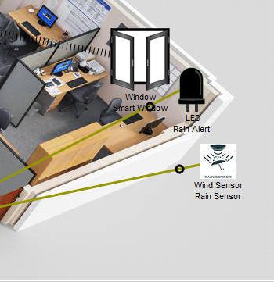
2.Smart Window

Slide 6
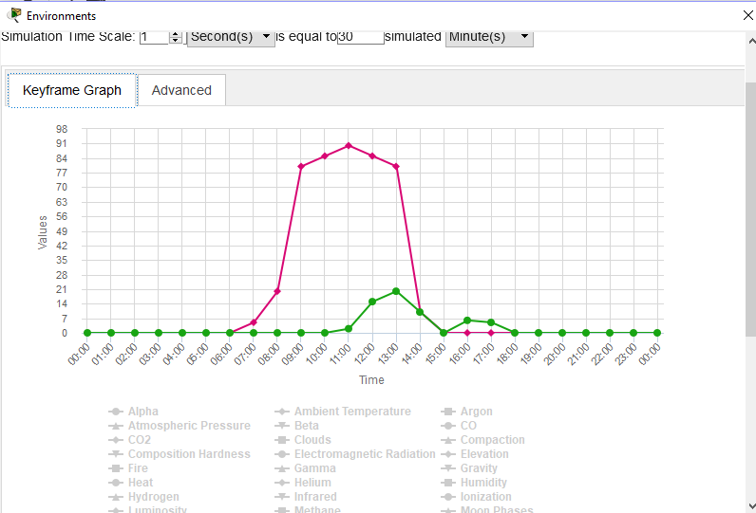
2.Smart Window

Slide 7
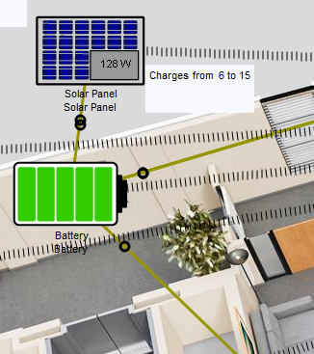
3.Solar Battery Charging

Slide 8
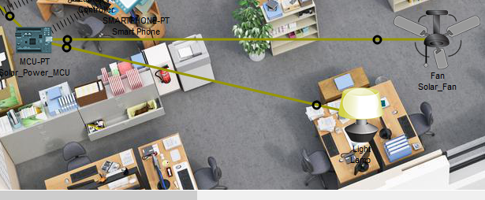
3.Solar Battery Charging

Slide 9
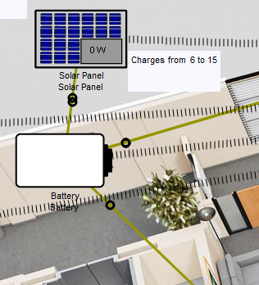
3.Solar Battery Charging

Slide 10
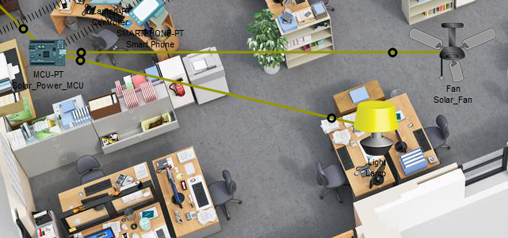
3.Solar Battery Charging

Slide 11
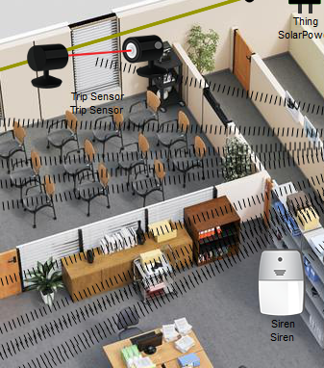
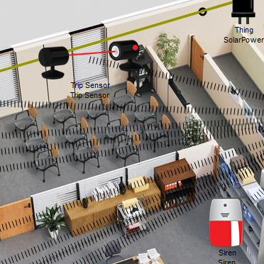
4.Anti-Theft protection

Slide 12
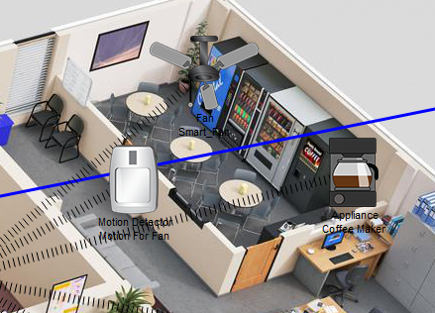
5.Auto fan and coffee maker

Slide 13
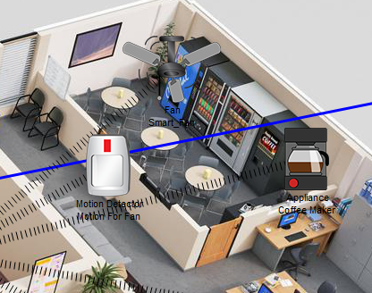
5.Auto fan and coffee maker

Slide 14
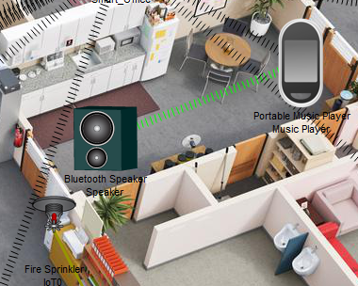
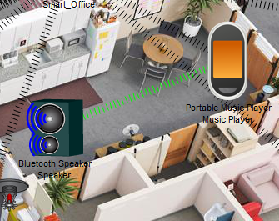
6.Music Player

Slide 15
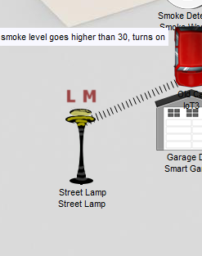
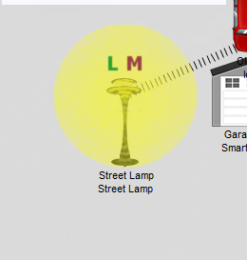
7.Smart Street Lamp

Slide 16
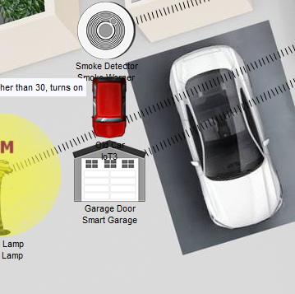
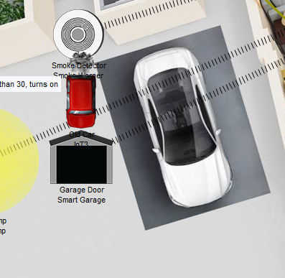
8.Smart Garage

Slide 17
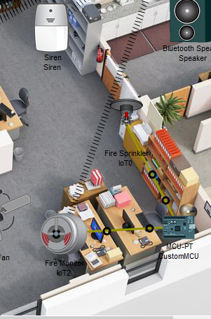
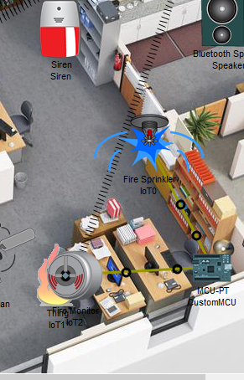
9.Fire/Smoke Alarm

Slide 18
Thanks!

